Slide 1
Nuclear Fuel Performance
NE-533
Spring 2023

Slide 2
Last Time
Radiation effects in UO2
Thermal conductivity degradation
Formation of the HBS
Started fuel chemistry

Slide 3
MOOSE Project Part 2
0.5 cm
0.1 cm
0.002 cm
Fuel pin dimensions listed – 2D RZ
Assume reasonable values for thermal conductivities, constant
Utilize axial T_{cool}, with T_{cool}^{in}= 500 K, reasonable flow rate, heat capacity, etc.
Utilize axial LHR, with LHR⁰=350 W/cm
Solve temperature profile for:
@ z=0.25, z=0.5, z=1
Solve for centerline temperature vs time
Transient: LHR⁰ = 500*[(t/100)^0.5]*[(1-(t/100))^4] + 150
@ z=0.25, z=0.5, z=1
Find location of peak centerline temperature at steady-state and at t=100 in transient
Due March 31
1 m
Fuel
Gap
Cladding

Slide 4
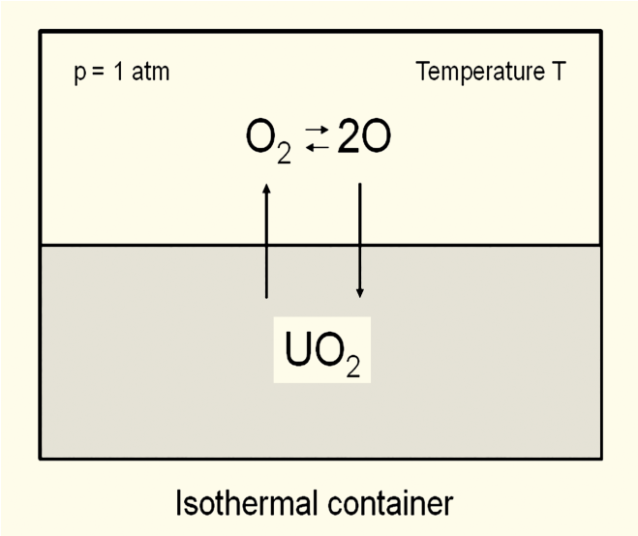
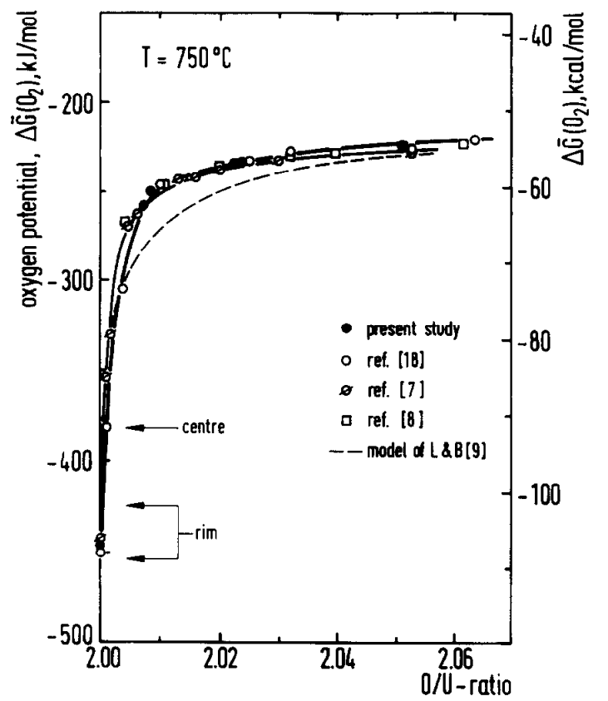
Oxygen potential
The oxygen potential is a measure of how free the oxygen is to escape/move around
Oxygen potential is defined as:
or, equivalently:
With = Chemical potential of oxygen in solution
= Gibbs free energy of gaseous oxygen at temperature T and a standard pressure (1 atm)
It is possible to determine the stoichiometry from the oxygen potential

Slide 5
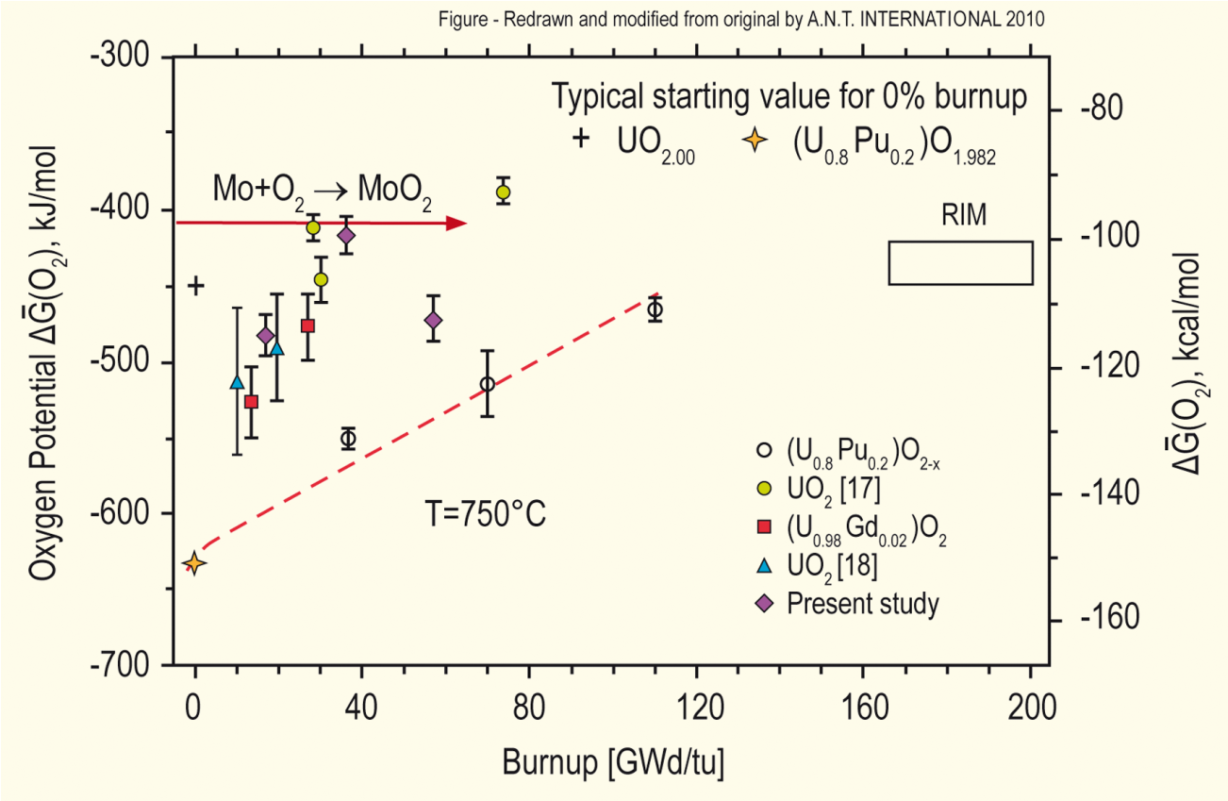
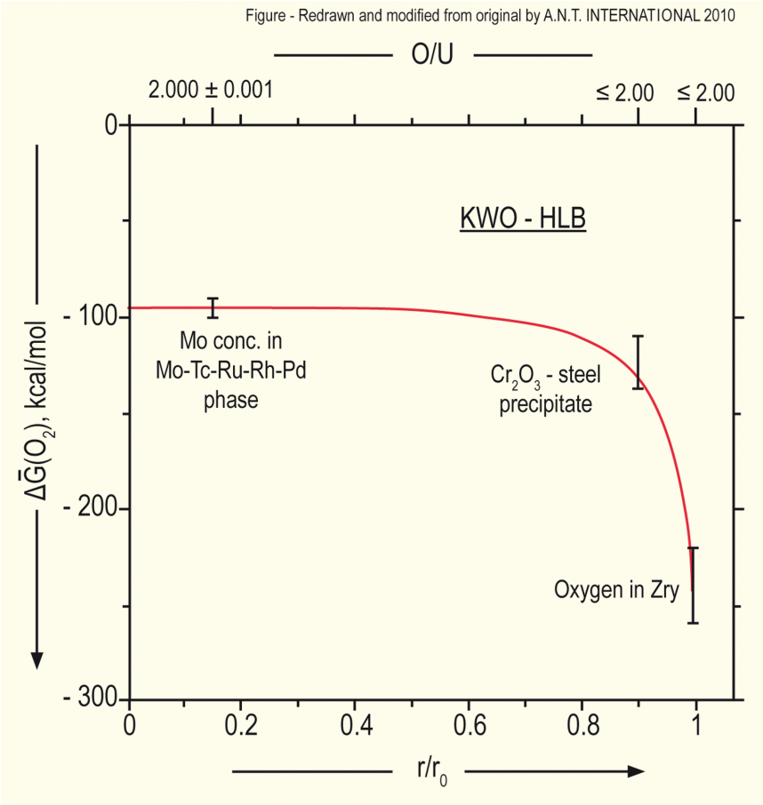
Oxygen potential
The oxygen potential changes during irradiation, indicating change in the O/M ratio
Oxygen potential changes during irradiation due to
Liberation of oxygen by fission; Generation of fission products; Conversion of uranium to plutonium; Reaction of oxygen with U, Pu, fission products, and cladding
Oxygen potential across pellet radius observed to be constant at the approximate value of Mo/MoO₂ reaction (from calculations)
Mo serves as a buffer to the O potential, or a means of inferring what the oxygen potential may have been in the fuel from PIE
Oxygen potential is low near the cladding, because the oxygen enters the cladding

Slide 6
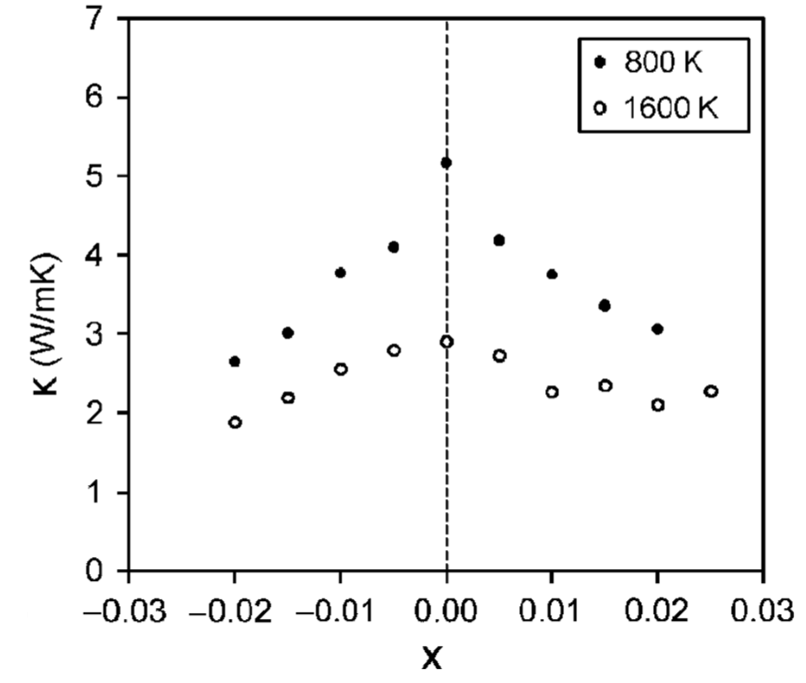
Fuel Stoichiometry/Properties
The stoichiometry of the fuel directly impacts the fuel performance
Stoichiometry impacts
Melting temperature
Thermal conductivity
Processes dependent on diffusion
Grain growth
Fission gas release
Creep
Chemical state and behavior of fission products
Chemical reactions at inner cladding surface
Thermal conductivity is highest for stoichiometric UO2

Slide 7
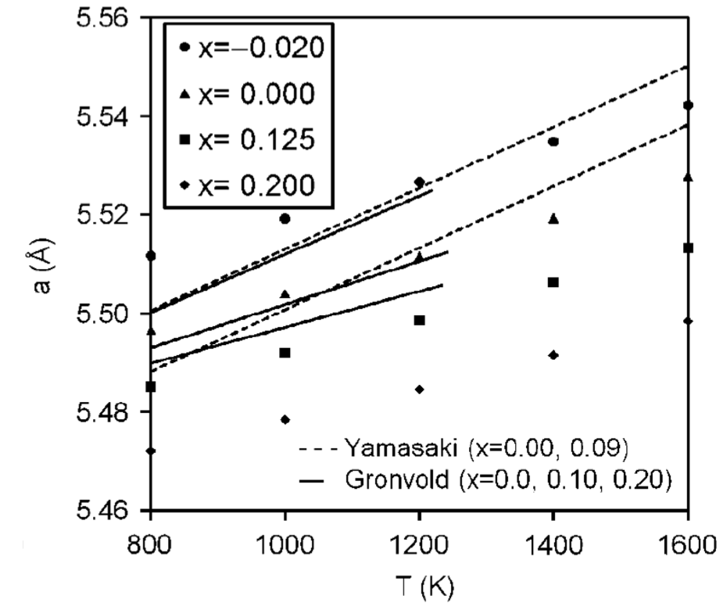
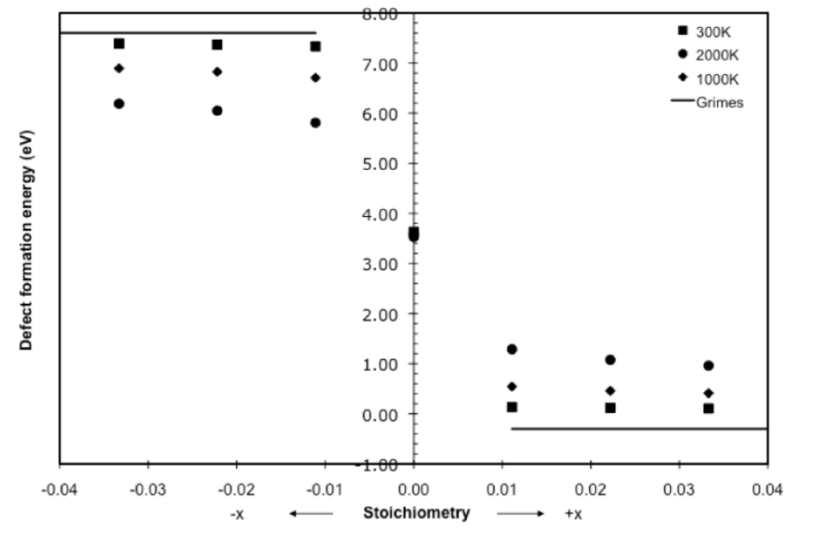
Fuel Stoichiometry/Properties
The lattice constant of the material decreases with increasing stoichiometry
The vacancy formation energy also changes with stoichiometry

Slide 8
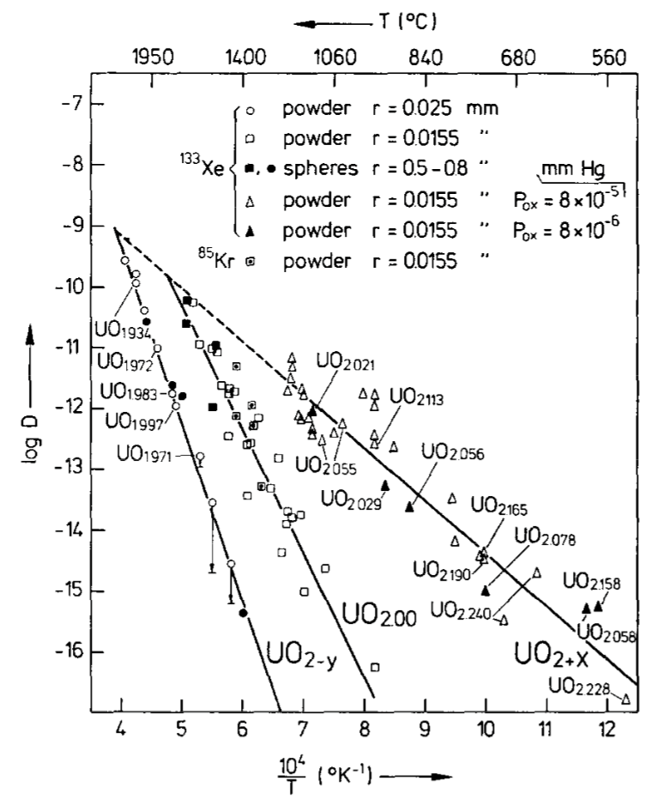
Fuel Stoichiometry/Properties
Fission product | UO_{1.97} | UO₂ | UO_{2.03}
Xe | 3.88 eV | 3.88 ev | 2.61 eV
Cs | 1.7 eV | -0.04 eV | -3.29 eV
Sr | -3.71 eV | -6.03 eV | -9.55 eV
The solution energy of Xe, Cs, and Sr in UO₂ depends on stoichiometry as well
The coefficient defining Xe diffusion also changes with stoichiometry
Though stoichiometry matters, most fuel performance codes ignore it

Slide 9
Fuel Chemistry Summary
UO₂ has a cubic fluorite structure that is very stable
The charges are balanced with a U⁴⁺ valence state
However, the ratio of oxygen to uranium can change. We call this the stoichiometry and abbreviate it as O/M ratio
The O/M ratio changes during reactor operation, but it is complicated
The O/M ratio impacts many properties of the fuel

Slide 10
grain Properties/Behavior

Slide 11
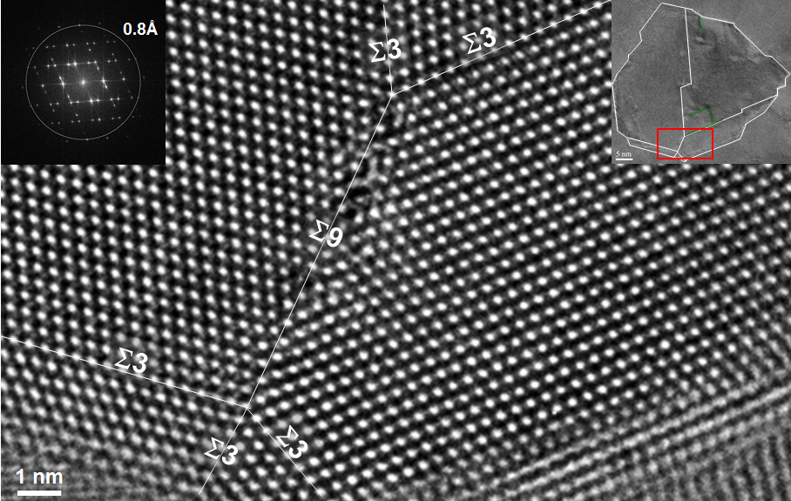
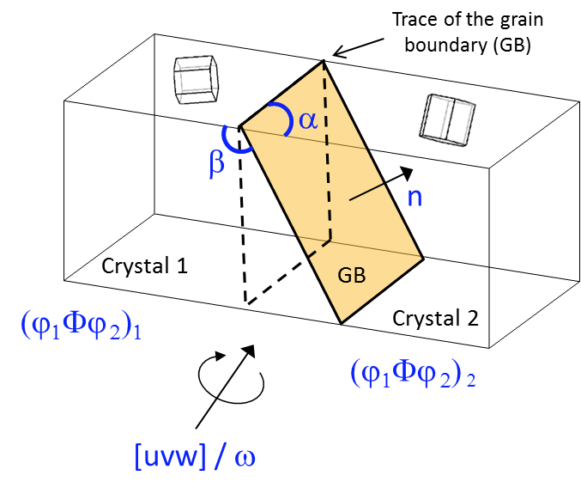
Grain Boundaries
Materials are typically composed of various regions where the crystal lattice is oriented differently
When two grains meet, there is a plane of atoms that do not follow the crystal lattice called a grain boundary
Grain boundaries add energy to the material that is a function of their structure
A grain boundary’s energy is determined by its:
Inclination – the orientation of the 2D grain boundary plane (2 degrees of freedom)
misorientation – the rotation required to align one grain with the other (3 degrees of freedom)

Slide 12
Grain Texture
The orientation of all the grains in a material is called the texture
The degree of texture is dependent on the percentage of crystals having a preferred orientation
randomly oriented grains equals no texture
Texture is seen in almost all engineered materials, and can have a great influence on materials properties

Slide 13
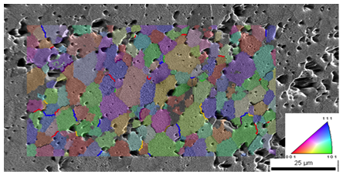
Grain size
In a polycrystal, there is also a distribution of grain sizes
The average grain size of the fuel has a significant impact on its behavior
Typical LWR fuel has an initial average grain size of about 10 microns
The average grain size impacts
Fission gas release
Swelling
Thermal conductivity
Creep

Slide 14
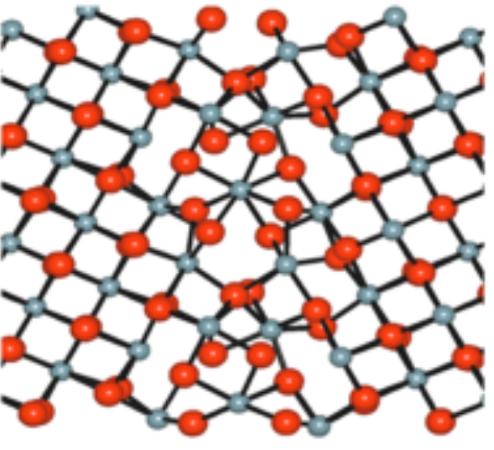
Grain boundary diffusion
Diffusion often occurs faster along grain boundaries than in the perfect crystal
Grain boundaries have more space than the perfect lattice
So, atoms diffuse faster along grain boundaries than through the perfect lattice
This means that grain boundary, or intergranular, diffusion increasingly dominates bulk (intragranular) diffusion
This can become more pronounced as the temperature is reduced
Grain boundary diffusion has a large impact on creep

Slide 15
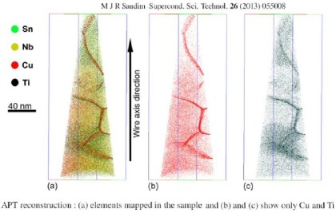
Grain boundary segregation
Impurity atoms (such as fission gas) and other defects move to grain boundaries
Due to grain boundaries having more open space, impurity atoms have a lower energy when they are on grain boundaries.
This is called grain boundary segregation
Radiation induced segregation (RIS) is where radiation produces defects that drive towards the grain boundary and preferentially drag solute atoms

Slide 16
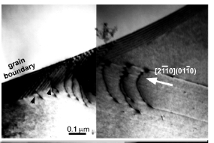
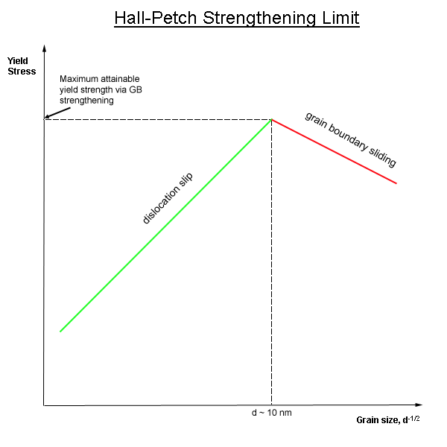
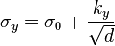
Dislocation interaction with grain boundaries
Grain boundaries impede dislocation motion
The number of dislocations within a grain impacts how easily dislocations can traverse grain boundaries and travel from grain to grain
So, by changing grain size one changes barrier density, influencing dislocation movement and yield strength
This is called the Hall-Petch effect
where σ_{y} is the yield stress, σ₀ is a materials constant for the starting stress for dislocation movement (or the resistance of the lattice to dislocation motion), k_{y} is the strengthening coefficient (a constant specific to each material), and d is the average grain diameter

Slide 17
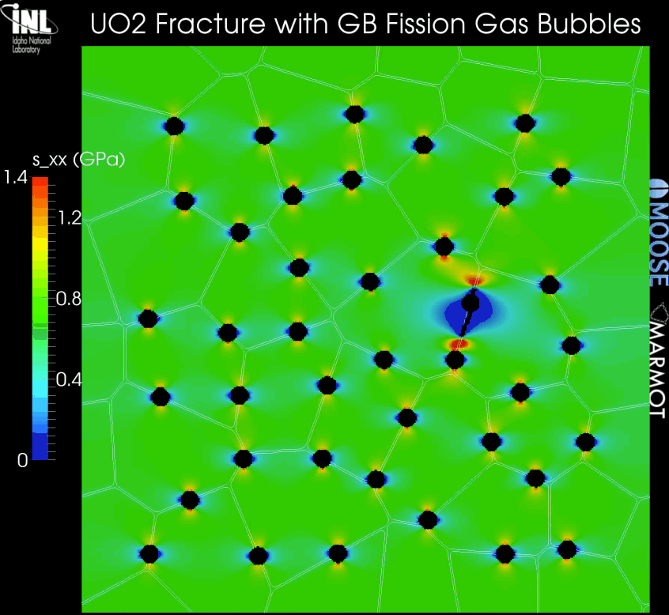
Grain boundaries and cracks
Materials often crack along grain boundaries
Grain boundaries can be weaker than the perfect lattice
different bonding environment, increased extrinsic particles, etc.
Thus, fracture will often occur along grain boundaries (intergranular fracture)

Slide 18
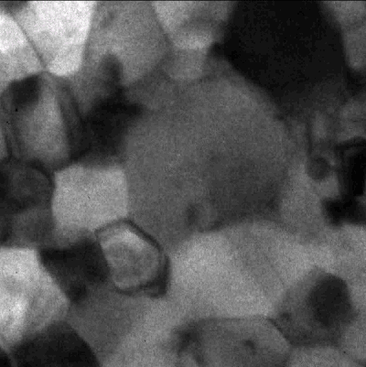
Grain size change
A single crystal has a lower energy state than a polycrystal, due to the grain boundary energy
So, grain boundaries migrate to reduce the energy
v_{GB} = M_{GB} (P_{d} – P_{r})
M_{GB} is the grain boundary mobility
P_{d} is the driving force (pressure) for grain growth
P_{r} is the pressure resisting grain growth

Slide 19
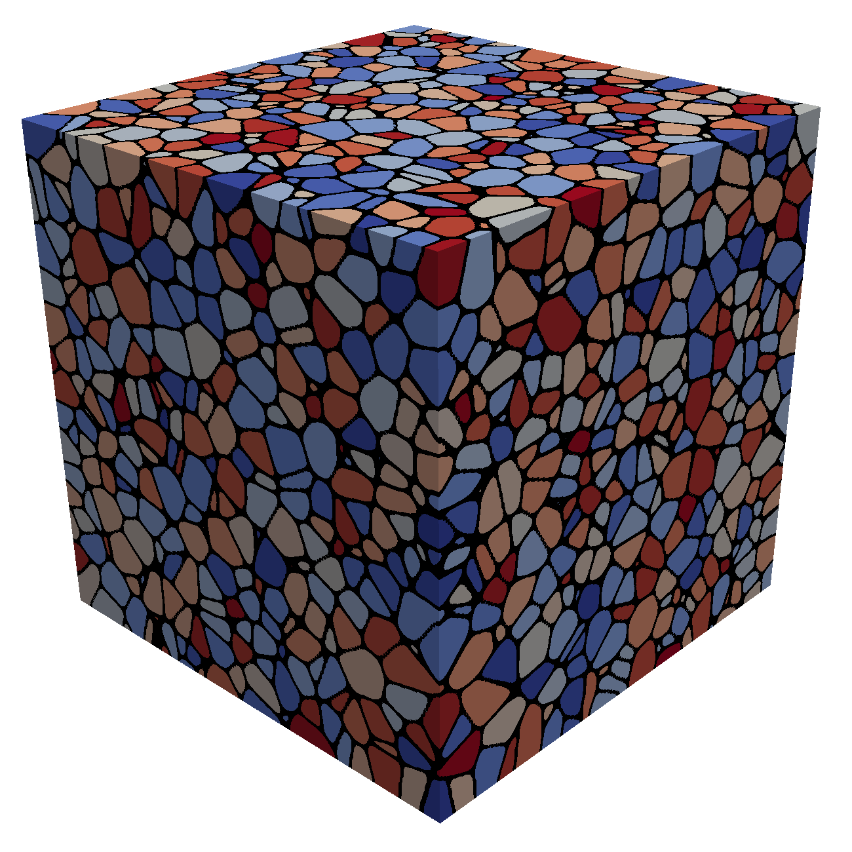
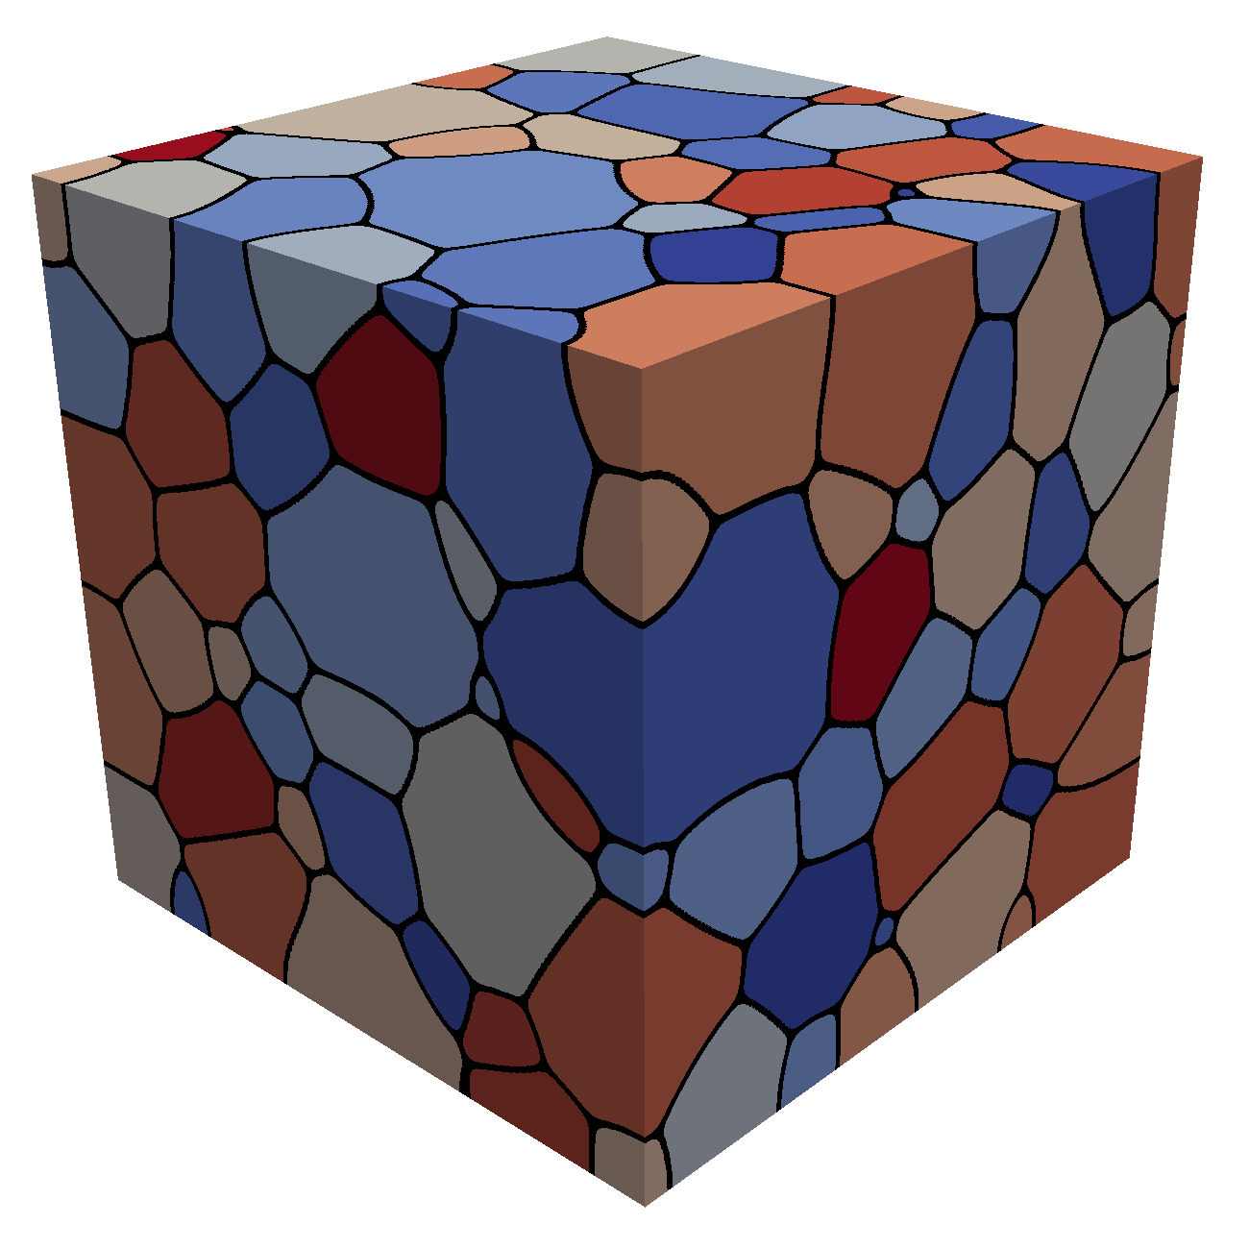
Grain growth
Due to grain boundary migration, the average grain size goes up with time during annealing/heat treating
As grain boundaries migrate, some grains grow and some shrink
Shrinking grains eventually disappear
The average grain volume
Therefore, as N_{grains} decreases due to grain disappearance, the average grain volume goes up

Slide 20
Grain boundary mobility
The grain boundary mobility is a function of temperature and GrB type
The grain boundary mobility is determined according to
m⁴/(J s)
k_{b} = 8.6173e-5 eV/K is the Boltzmann constant
Both the pre-factor M₀ and the activation energy Q change as a function of the grain boundary misorientation
We often use an average grain boundary for a material, taken from polycrystal measurements-> UO2: M₀ (m⁴ /J-s) = 4.6e-09, Q (eV) = 2.77
What is the mobility of UO₂ at 1600 K?
M_{GB} = 4.6e-9*exp(-2.77/(1600*8.6173303e-5)= 8.7e-18 m⁴/J-s

Slide 21
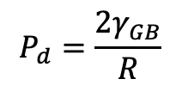
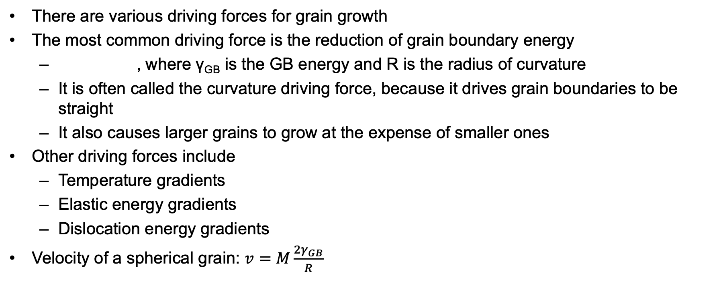
Grain growth
There are various driving forces for grain growth
The most common driving force is the reduction of grain boundary energy
, where γ_{GB} is the GB energy and R is the radius of curvature
It is often called the curvature driving force, because it drives grain boundaries to be straight
It also causes larger grains to grow at the expense of smaller ones
Other driving forces include
Temperature gradients
Elastic energy gradients
Dislocation energy gradients
Velocity of a spherical grain: $v=M\frac{{2γ}_{GB}}{R}$
$$P_{d}=\frac{{2γ}_{GB}}{R}$$

Slide 22
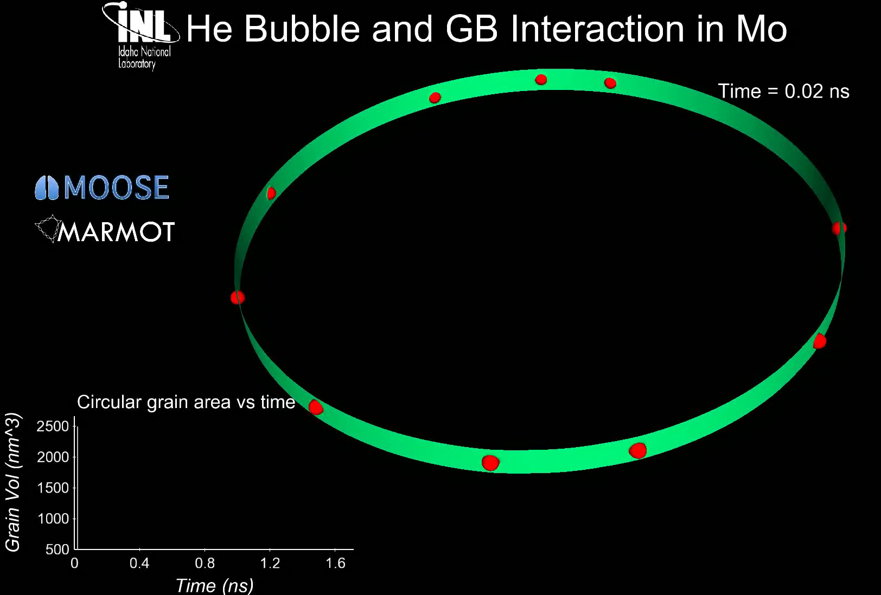
Grain growth
Grain boundary motion is inhibited by pores, precipitates, solute atoms, etc.
Solute atoms (whether in interstitial sites or vacancies) can decrease the grain boundary mobility.
This is called Solute Drag
Even a small concentration of impurities can decrease the mobility by 3 to 4 orders of magnitude
Particles and pores resist grain boundary motion

Slide 23
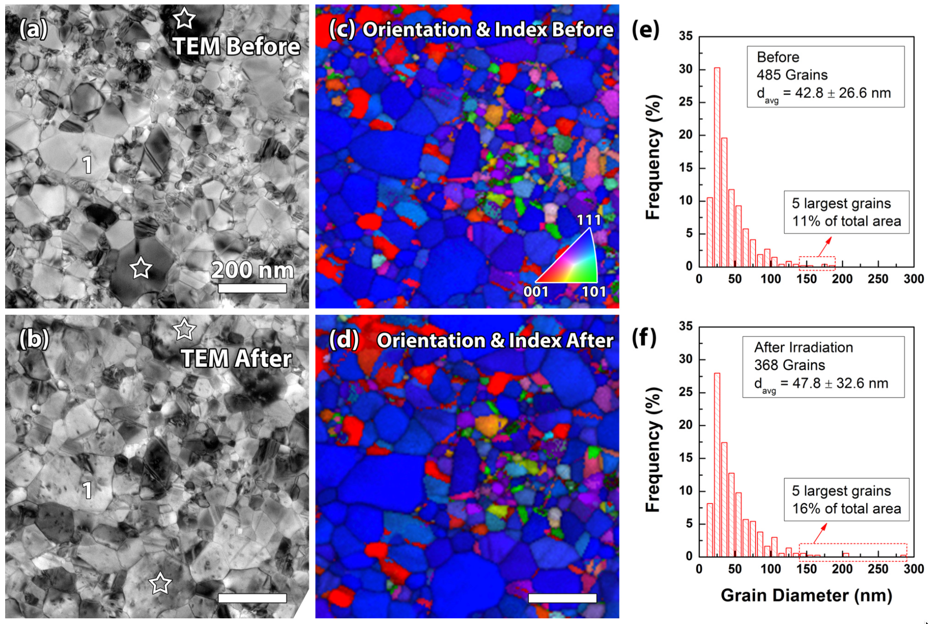
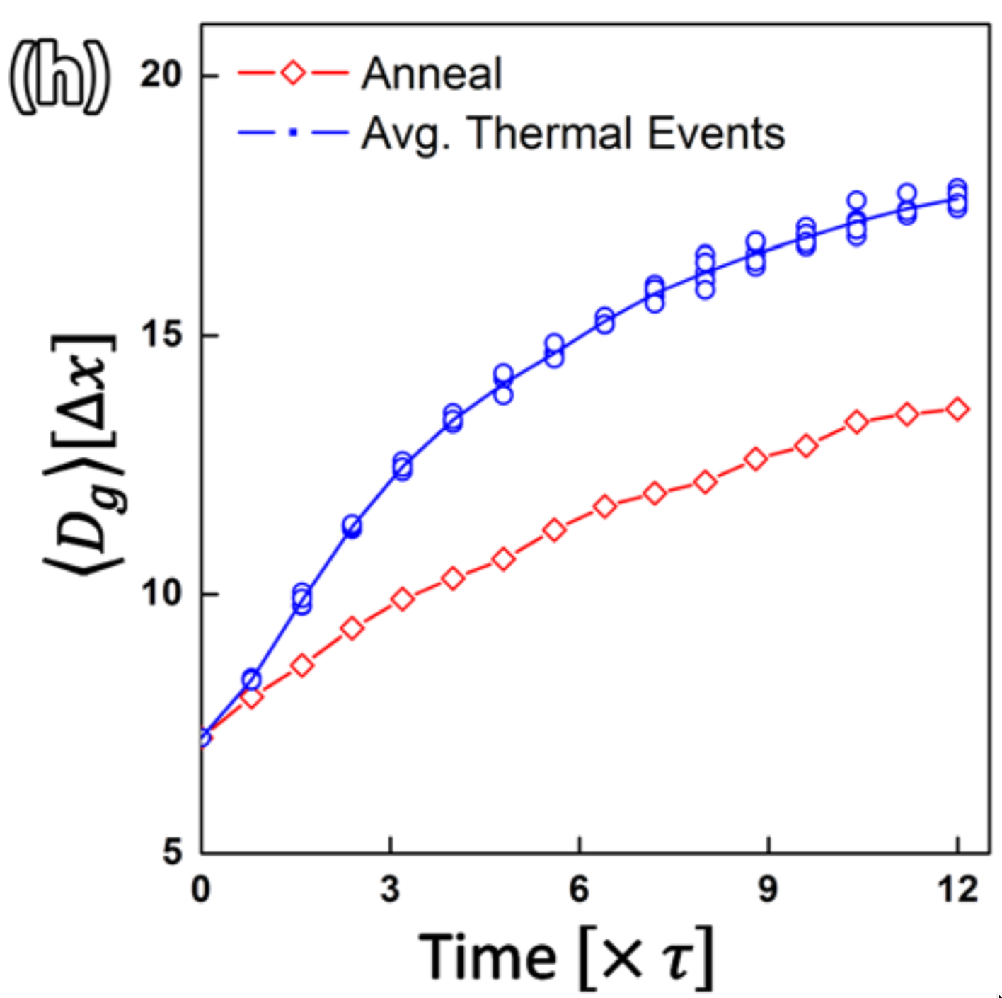
Irradiation can accelerate grain growth, but it is only significant with small grains and low temperature

Slide 24
Maximum grain size
Consider a material with an average grain size D
The change in D can be written as
k = 2 M_{GB} γ_{GB} is a rate constant that can be determined from experiments
D_{m} is the grain size at which the driving force equals the resistive pressure
For UO2:
D_{m} is a function of temperature microns

Slide 25
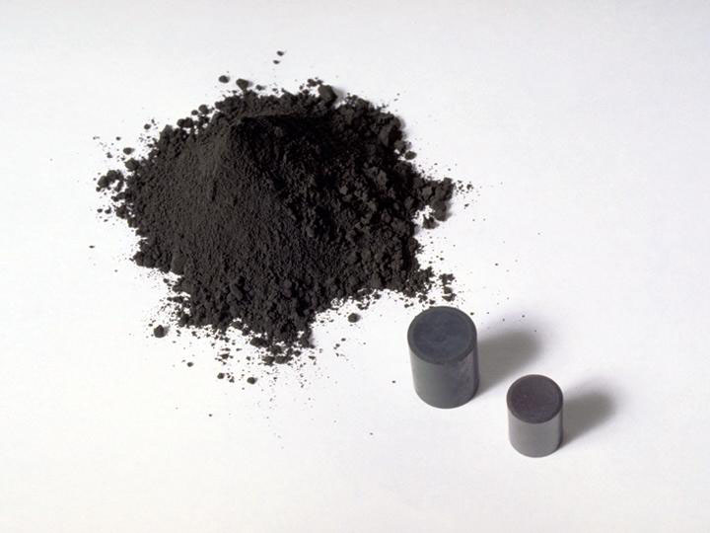
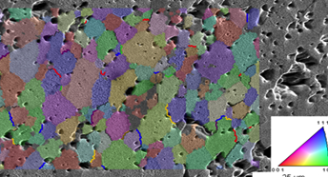
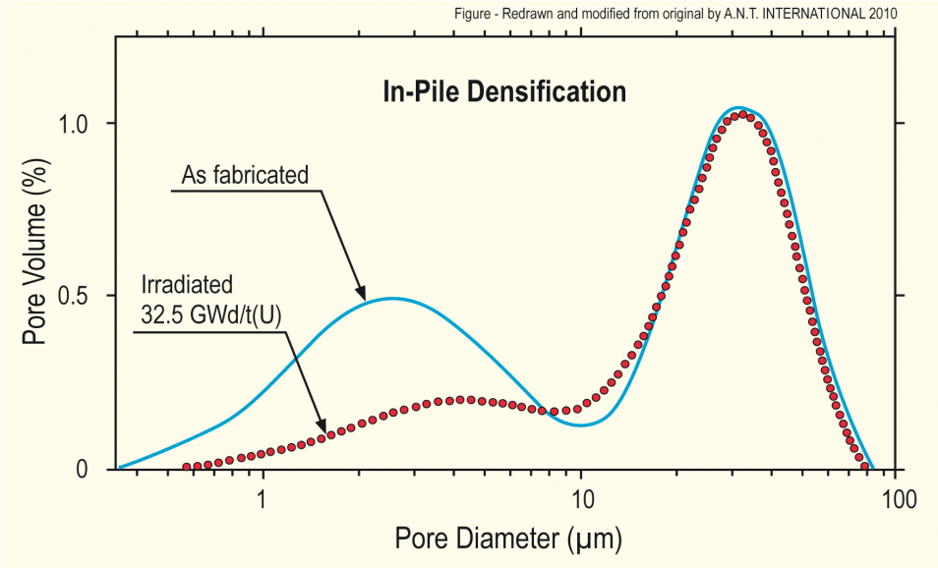
Fuel Densification
Remember that fresh fuel pellets are not fabricated to be 100% dense, more like 95-99% dense
Early in life, fuel pellets shrink and the initial porosity is largely eliminated
In some ways, densification is a continuation of the sintering process
However, irradiation accelerates the process
Small pores close due to effects of fission spikes and vacancy diffusion
Large pores stable (in absence of large hydrostatic stress)
Pellets with higher initial density, densify less

Slide 26
Densification
The driving force for densification is the change in free energy from the decrease in surface area of pores and lowering of the surface free energy
An empirical relation to describe densification has been built as a function of
β - Burnup (in FIMA)
Δρ₀ – Total densification that can occur ~ 0.01
β_{D} – Burnup at which densification stops ~5 MWD/kgU, ~0.005 FIMA
C_{D} = 7.235 − 0.0086 (T − 25) for T < 750C and CD = 1 for T ≥ 750C

Slide 27
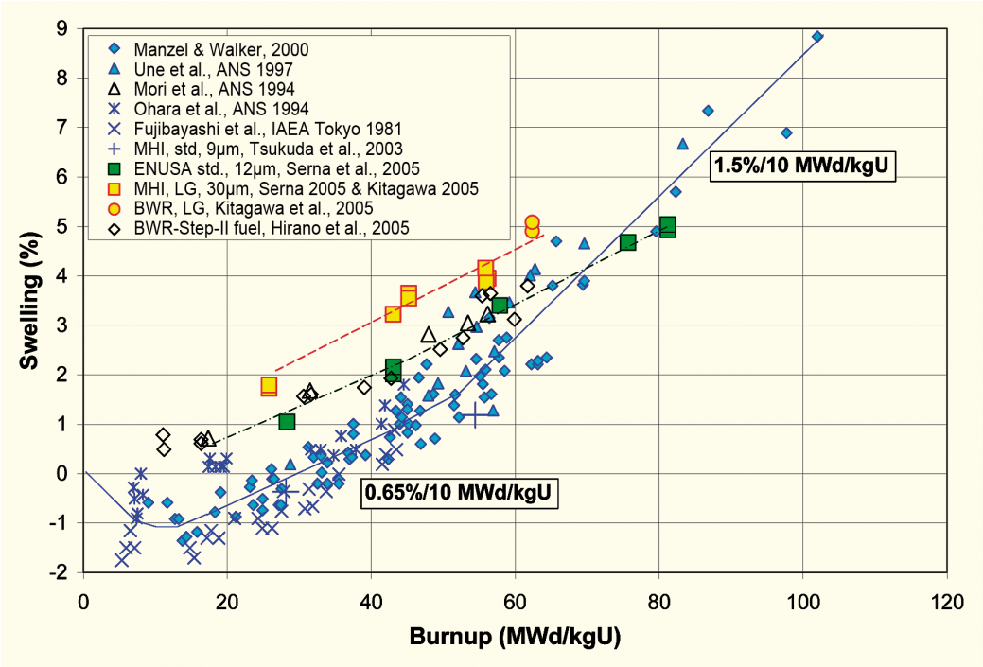
Empirical models
Many models of reactor fuel behavior are fits to experimental data
They are typically correlated to burnup
Burnup is a measure of how much fissioning has taken place. Typical units are:
MWD/kgU
FIMA
It can be calculated from the volumetric fission rate
Units of this equation are FIMA
To convert from FIMA to MWD/kgU, multiply by 950
after Garzarolli in [Rudling et al, 2007]

Slide 28
Summary
The average grain size in UO₂ impacts fuel behavior and performance:
Fission gas release
Swelling
Thermal conductivity
Creep
The material wants to reduce its energy by having large grains grow at the expense of small grains
Grain growth is reduced due to other defects reducing the grain boundary migration
Fuel densification is driven by reduction in surface area of pores – continuation of sintering process
Empirical models describe densification as a function of burnup

Slide 29
Fission products

Slide 30
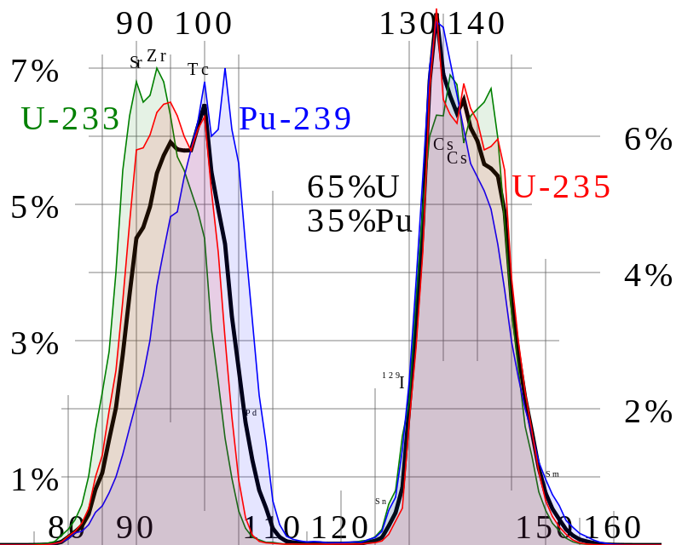
Fission Product Generation
Fission releases around 200 MeV
The fission fragments have 169 MeV of kinetic energy
2 to 3 neutrons with an average energy of 2 MeV
7 MeV of prompt gamma ray photons
The remaining energy is released by beta decay
Every fission product that is produced is now in the crystal lattice of the fuel, changing the microstructure

Slide 31
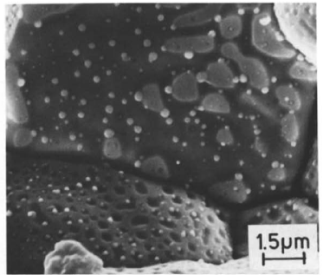
There are various types of fission products that form in the fuel
Soluble oxides (Y, La and the rare earths)
Dissolved in the cation sublattice
Insoluble oxides (Zr, Ba and Sr)
Form insoluble oxides in the fluorite lattice
Metals (Mo, Ru, Pd, and Tc)
Form metallic precipitates
Volatiles (Br, Rb, Te, I and Cs)
Exist as gases at high temperatures of the pellet interior
Also exist as solids at the cooler pellet exterior
Noble gases (Xe, Kr)
Essentially insoluble in the fuel matrix
Form either intragranular (within grain) voids or bubbles or intergranular (grain boundary) bubbles

Slide 32
All of the fission products impact the behavior of the fuel

Slide 33

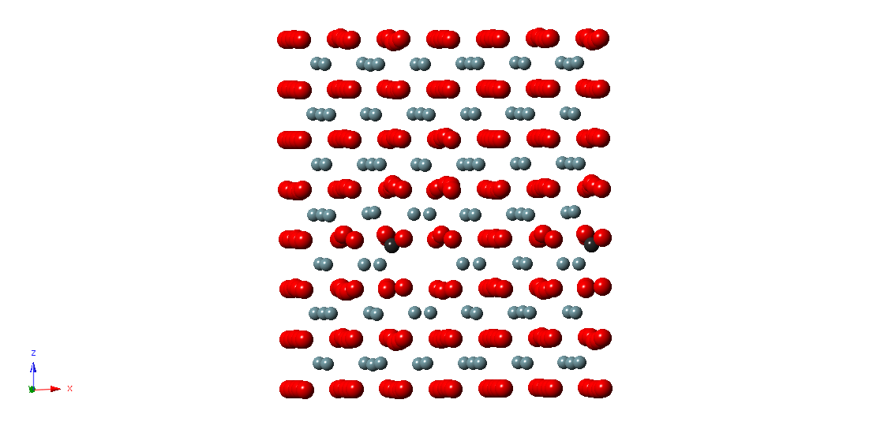
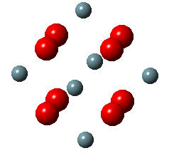
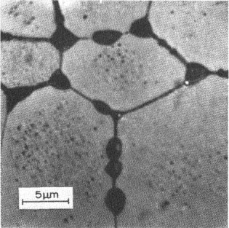
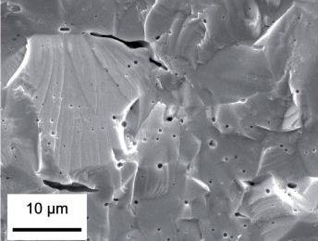
Fission Gas Release
Fission gases (Xe, Kr) are released in a process composed of three stages in UO2
Stage 1: Gas atoms are produced throughout the fuel due to fission and diffuse towards grain boundaries
Small intragranular bubbles form within the grains, but never get larger than a few nm radius due to resolution from energized particles
Gas atoms that don’t get trapped within the intragranular bubbles migrate to grain boundaries
Atoms forming a vacancy cluster

Slide 34
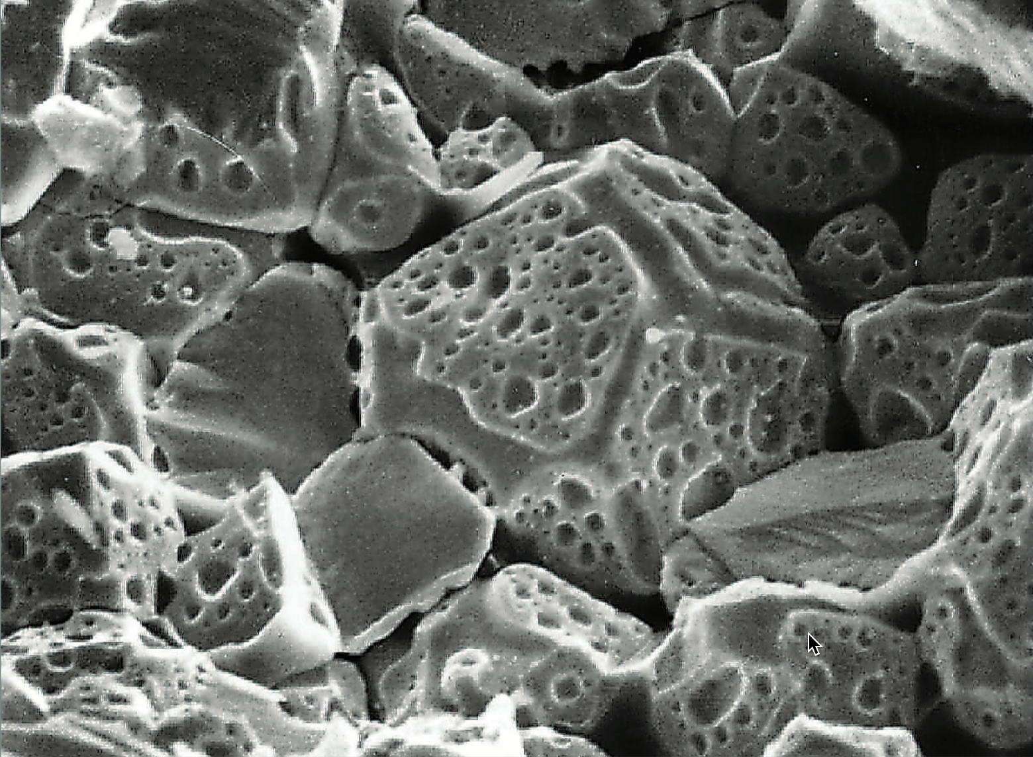
Fission Gas Release
Stage 2: Gas bubbles nucleate on grain boundaries, growing and interconnecting
Stage 3: Gas travels through interconnected bubbles to a free surface

Slide 35
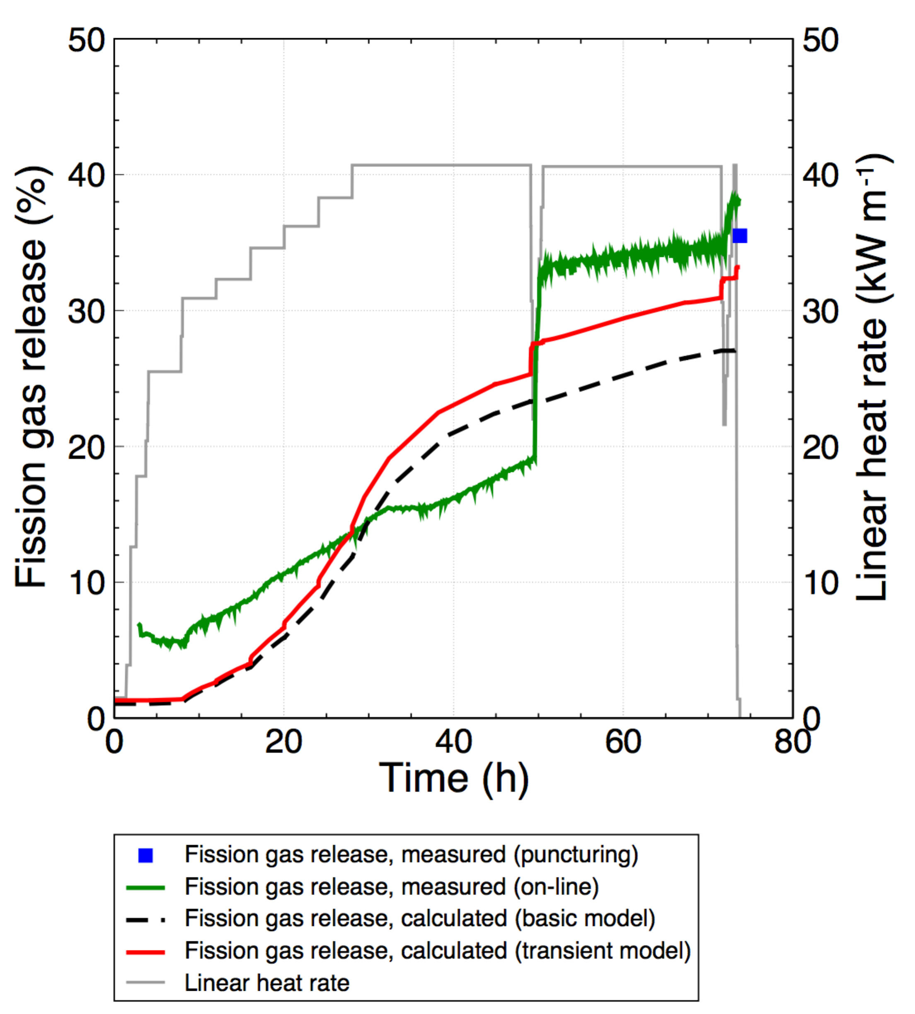
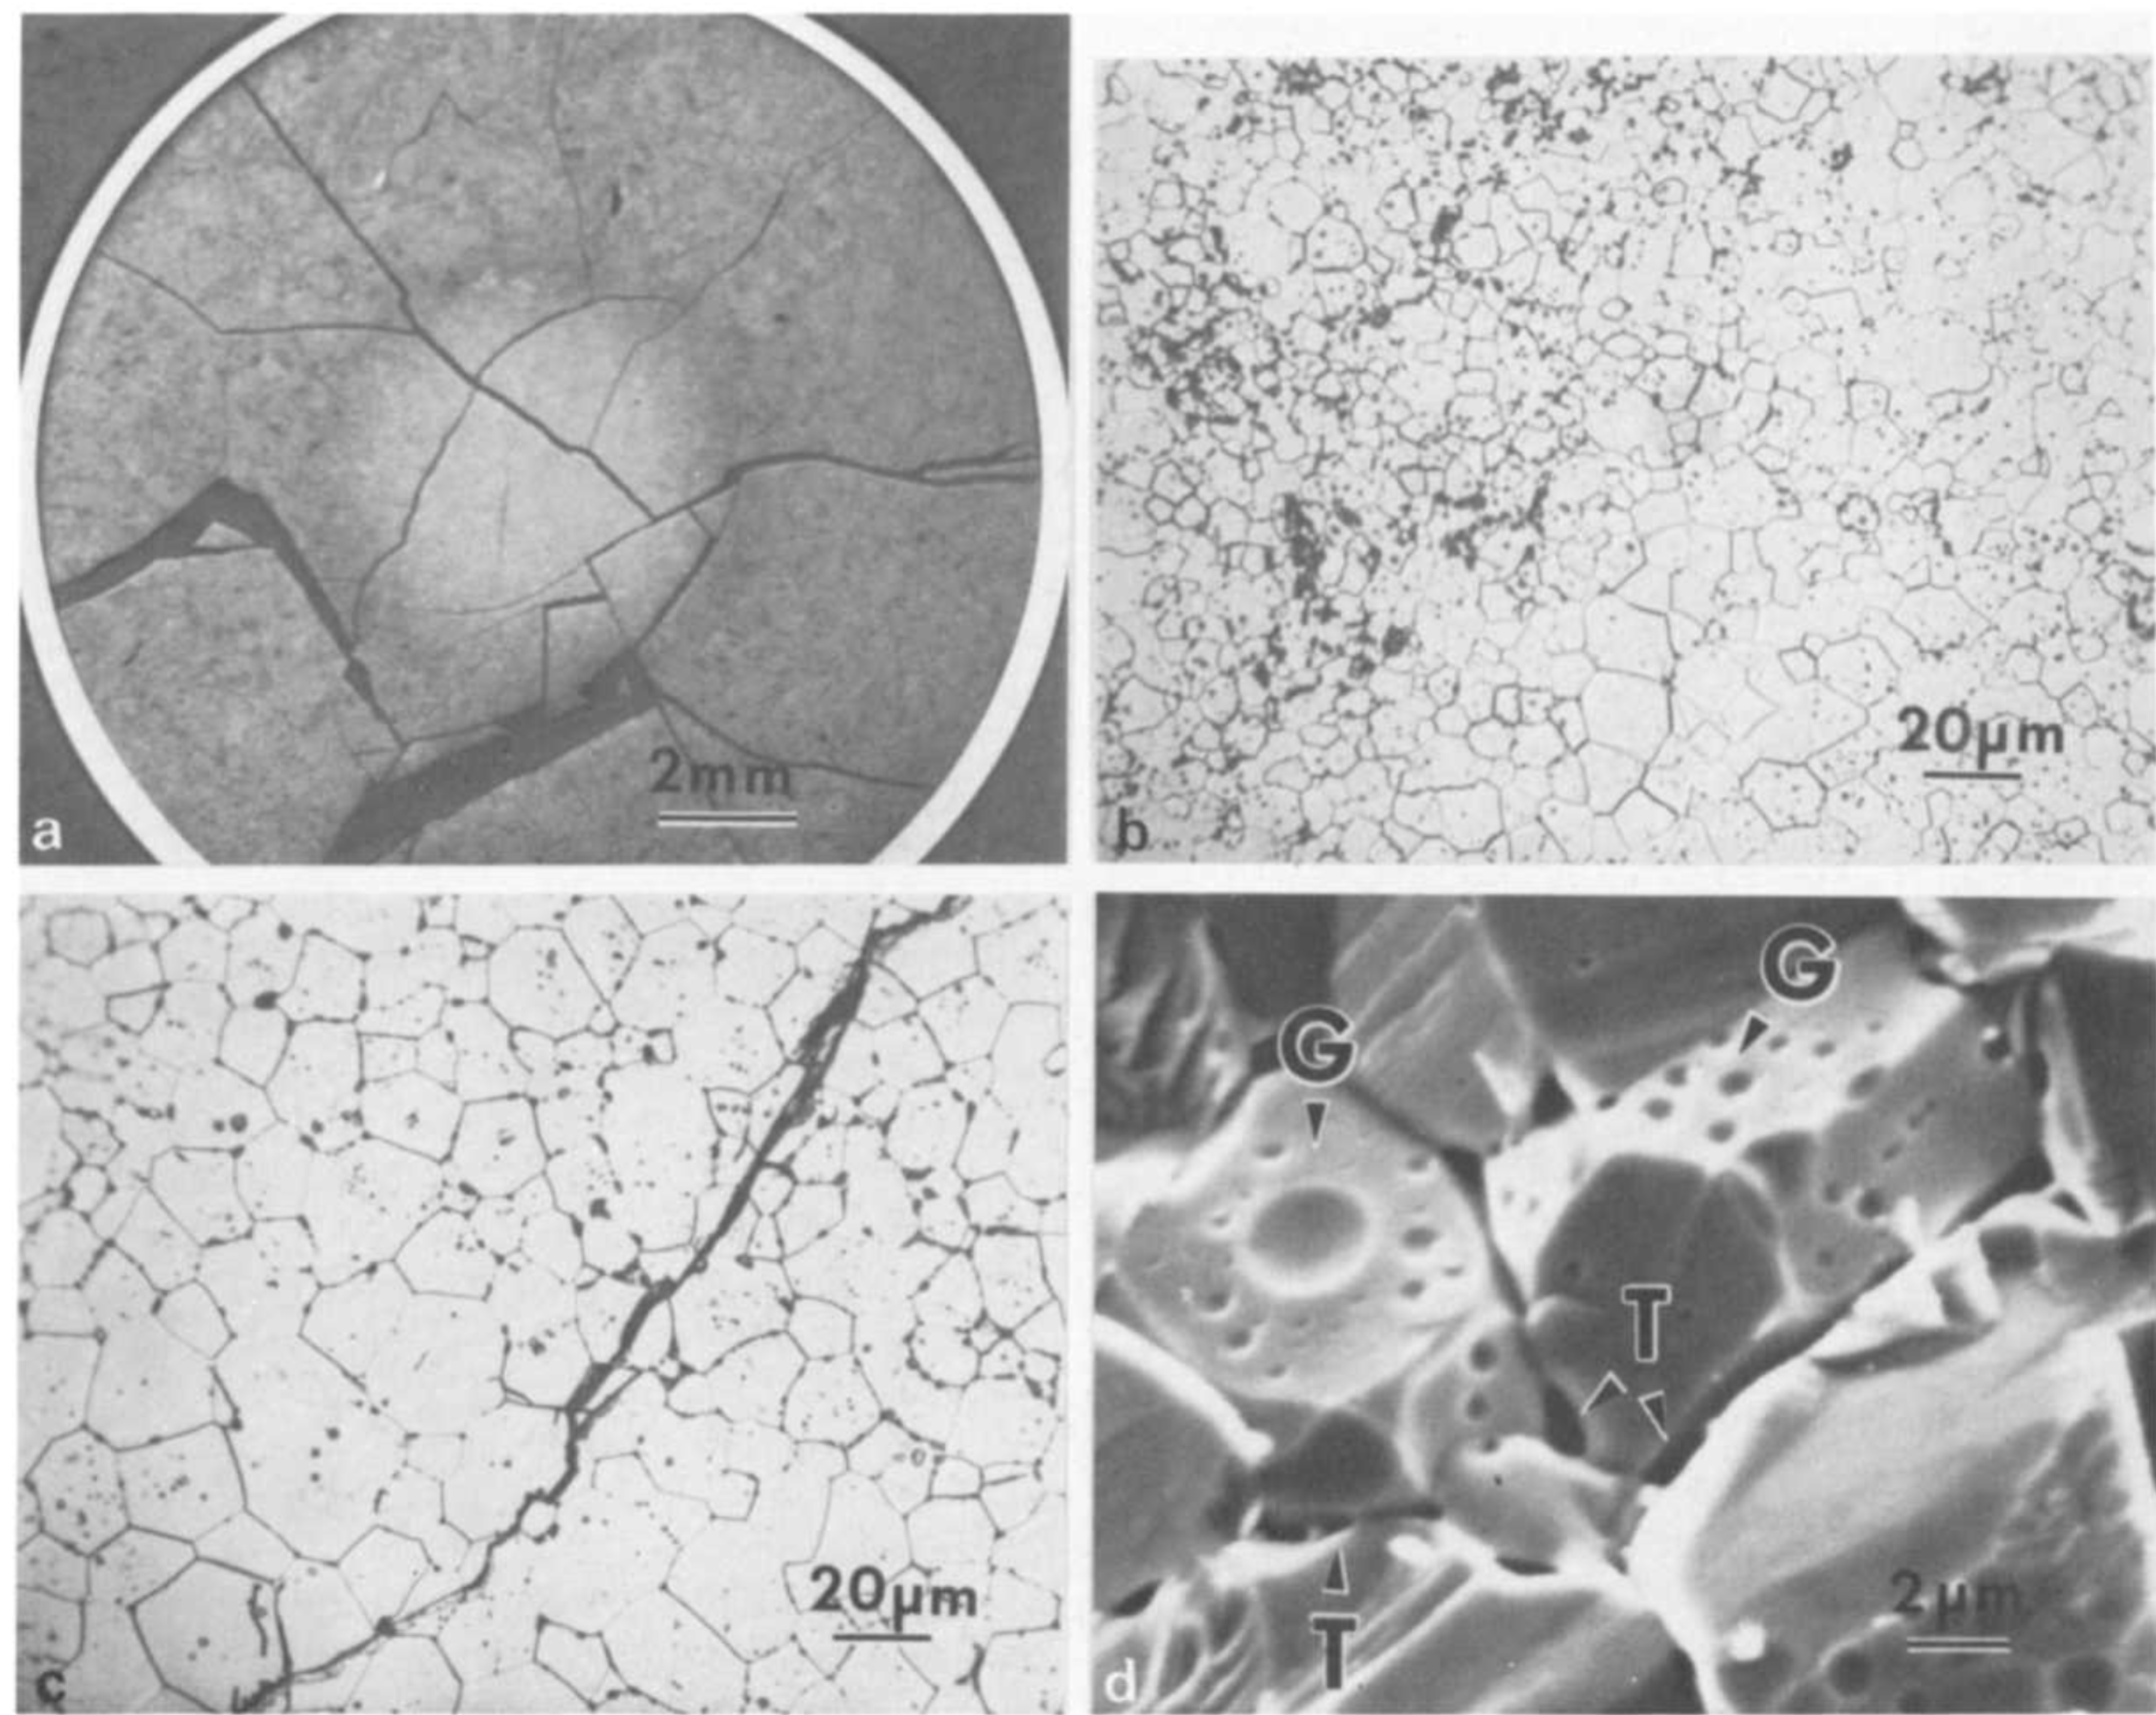
Fission Gas Release
Fission gas release also occurs due to mechanisms that don’t depend on diffusion
Release can occur to particle recoil and knockout at low temperature
It can occur due to fracture during rapid transients

Slide 36
Fission Gas Release
Released fission gas enters the gap and plenum, causing various problems
Xe and Kr have very low thermal conductivities, reducing the gap conductance
The plenum pressure increases
The volatile fission gases corrode the cladding
They are also radioactive and hazardous, causing problems when the cladding is breached
Fission gas release experiments:
Post irradiation annealing
Fuel is irradiated at low temperature
Fuel is then placed into a furnace and heated
Gas atom release is then measured
In-pile release
Gas release is measured during reactor operation
It is much more difficult than post-irradiation annealing
Total amount released is measured by puncturing cladding after irradiation
Release with time can be estimated using a pressure transducer inside an instrumented fuel rod

Slide 37
Fission Gas Release
Fission gas release models attempt to predict the rate at which gas is released from the fuel
To model fission gas release, ideally we must model all three stages of gas release
Diffusion of gas atoms to grain boundaries
Growth and interconnection of grain boundary bubbles
Transport of gas atoms through interconnected bubbles to free surfaces
The earliest models only considered Stage 1
Most models now consider stage 1 and 2
There are no models that consider all three stages, but some are under development

Slide 38
Summary
Five families of fission products
Fission products change the fuel behavior
Fission gas is released in three stages
Fission gas production and diffusion to grain boundaries
Grain boundary bubble nucleation, growth, and interconnection
Gas transport through interconnected bubbles to free surfaces
Fission gas release is measured using post-irradiation annealing and/or in pile experiments

